Slide 1
Year 2 Week beginning Monday 4th May 2020
Dear Parents,
Please find attached a timetable of activities that your child can complete this week. All activities are hopefully able to be completed without resources needed from school. Purple-mash and Ed-shed are still being updated regularly with activities that can also be completed. The hope is that everyone is able to access some form of activity whether computer based or by completing these activities. If you have any problems please contact the school and help will given.
A great way to start the day is with a prayer, quiet time asking God to keep them safe and help them with their learning. It could either be a chance for quiet, to say the Our Father, Hail Mary or the School Morning Prayer. This could then be followed by Joe Wicks, the Body Coach at 9:00am to get them active.
Our school email addresses if you have any queries ntew@stanthonys.slough.sch.uk
esoton@stanthonys.slough.sch.uk KWoolley@StAnthonys.slough.sch.uk
Monday | Tuesday | Wednesday | Thursday | Friday
Literacy Last week you chose an African animal to write about. This week can you write a non chronological report about that animal. Today start with the introduction. Can you include a question sentence? | Literacy Continue with your non chronological report. Think about the sub headings you will use, such as ‘What it looks like’, ‘ Where it lives’ , ‘Amazing facts’. Chose 1 paragraph to write today. Can you include an exclamation sentence; remembering that they start with what or how and contain a verb (What a fast runner the leopard is!) | Literacy Today continue with your non chronological report, thinking about other key features of writing for year 2, such as contracted words (didn’t, can’t etc), extended noun phrases (The spotty leopard runs quickly, which is why it is known as the fastest animal) or similes ( The amazing leopard is as fast as lighting) or suffixes (ment, ness, ful, ly ie: enjoyment, cleverness, thoughtful, amazingly) | Literacy Today write your concluding paragraph for your non chronological report. Can you include a picture in your report? | Literacy Look back over your report. Can you add extra detail anywhere?

Slide 2
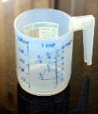
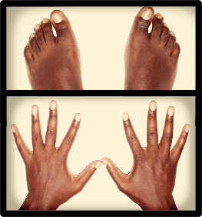
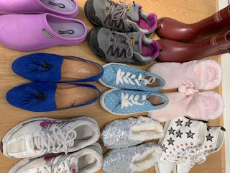


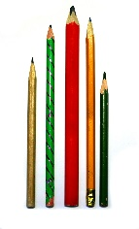
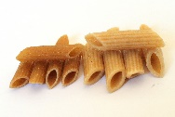
Monday Maths | Tuesday | Wednesday | Thursday | Friday
Data Collect all the shoes, slippers footwear in your house. How many groups can you sort them into? Set them into a pictogram. Size, colour, shiny, lace ups, straps with buckles, boots, slippers, sports etc. Take photos or create a chart of the groups. What was the most and least popular colour? Size? What was the smallest and largest sizes? Popular type of footwear? Who has the most or least shoes? What is the total amount of shoes? How quickly can you count in 2s! Think of some of your own questions. Tidy up afterwards. | Game: First one to get to 100. Today for each player you will need about 10 pencils or felt tip pens, 10 pieces of pasta or small objects and a dice. Take turns to roll the dice. If you get 4 take 4 pieces of pasta. On your next turn if you roll 6 take 6 pieces of pasta. You have now got ten so you exchange for a pencil or pen. The first one to get 10 pencils (100) is the winner! EXT: 200 | Birthday numbers: You and your family members each have a birth date. 17.12.2015 Rewrite dates so that the year is shortened to the last 2 digits. 17.12.15 Add the first 2 numbers together 17+ 12= 29 29+15= 44 Draw and use a numberline or use other ways to help you. Then subtract the smaller 2 digit numbers from the larger one EXT: add the years 2015 +1985= | Capacity: Find 5/6 containers that hold liquid in. They don’t need to be full. Water, fizzy can, bottle, squash, cooking oil, milk, can of soup or sauce. Look for ml (millilitres) Put them in order from smallest to largest amounts. If you have a measuring jug, Add water to it every 50 millilitres. Ask mum to get you a 5 ml and 10 ml medicine spoon. Pour liquid onto the spoons and look at the amount. Choose different sized cups/beakers, fill them with water and one at a time tip into the empty jug to find out how much water they each contain. | Counting in 5s Draw around your and all your family’s hands with fingers and feet with toes. You may need to draw around some members twice to get to 100. Count on and back in 10s and then 5s.

Slide 3
Monday | Tuesday | Wednesday | Thursday | Friday
Reading Can you read your favourite story with a family member. You could also act it out. | P.E This is a great website: https://home.jasmineactive.com/login The username is: parent@stanthonys-2.com The password is: stanthonys | RE The Ascension The disciples went with Jesus to Bethany, just outside Jerusalem, he told them they had to wait in Jerusalem until the Holy Spirit came. As Jesus was blessing his disciples, he left them and returned to his father in Heaven. His disciples praised Jesus and went back to Jerusalem filled with great joy and spent their time praying as they waited for the Holy Spirit. Based on Luke 24: 48-52 Can you write a short paragraph about the feast of the Ascension, describing what happened and why this is important to Christians. Watch this video clip if you can to helphttps://www.youtube.com/watch?v=UcFw8pLBSIo | Science Can you make a chart of things that are living and non living? | Art Today is VE Day. VE day stands for Victory in Europe Day. On 7th May Germany surrendered. This meant that the second world war in Europe was over. This is why we celebrate VE day The following day was one of great celebration. William Churchill (England’s Prime Minister) made a speech in which he said: ‘My dear friends, this is your hour. This is not victory of a party or of any class. It's a victory of the great British nation as a whole.’ Communities had street parties and churches held services of thanksgiving. Can you decorate some bunting and have a party lunch with your family to celebrate VE Day
Living | Non living
Plants Cats Dogs | Car Chair Table

