Slide 1
Year 2 Week beginning Monday 11th May 2020
Dear Parents,
Please find attached a timetable of activities that your child can complete this week. All activities are hopefully able to be completed without resources needed from school. Purple-mash and Ed-shed are still being updated regularly with activities that can also be completed. The hope is that everyone is able to access some form of activity whether computer based or by completing these activities. If you have any problems please contact the school and help will given.
A great way to start the day is with a prayer, quiet time asking God to keep them safe and help them with their learning. It could either be a chance for quiet, to say the Our Father, Hail Mary or the School Morning Prayer. This could then be followed by Joe Wicks, the Body Coach at 9:00am to get them active.
Our school email addresses if you have any queries ntew@stanthonys.slough.sch.uk
esoton@stanthonys.slough.sch.uk KWoolley@StAnthonys.slough.sch.uk
Monday | Tuesday | Wednesday | Thursday | Friday
Literacy ‘Anansi and the yam hill’ is a popular African story. Watch the story being told on the link below. https://www.youtube.com/watch?v=C6UFodaFYSo Now think about the character of Anansi, what do you think it would look like? Draw the image that you imagined while you were listening to the story. It can be as imaginative as you like! | Literacy Using your picture of Anansi, today you are going to think about it’s appearance, that means what it looks like. This is my example; Amazingly, he has 8, tiny legs which he uses to run quickly across the ground. In addition, he looks very scary like an angry monster. Unbelievably, he is as black as the scary night and his legs are covered in fur. On his face, he has blood-red eyes which glow in the dark. In my paragraph I used Adverbs, adjectives, conjunctions, similes to add detail, now it’s your turn. | Literacy Today you are now going to think about Anansi’s personality, which means how it acts. Anansi is as cheeky as a monkey because he likes to trick all the animals. Think back to the story from Monday, you may even want to listen to it again so you can think of all the different choices Anansi makes good or bad to write about in your paragraph. Today try to include an exclamation sentence starting with ‘How’ or ‘What’ How cheeky Anansi is! What a cheeky spider Anansi is! | Literacy So far this week you have heard a new story, drawn what you think the main character looks like, then you have described the appearance and personality of the character. Today you are going to use your creative thinking skills to imagine things that Anansi would like and dislike. Anansi likes to trick all the animals so he can eat all their fruit without having to do any work at all. Use evidence from the story but your imagination too. | Literacy Let’s complete your character description about Anansi! Today you are going to answer this one question. Would you like to be Anansi’s friend? Give reasons for or against your decision. I think you will need to include a variety of conjunctions to justify your answer; because, therefore, so that, however

Slide 2
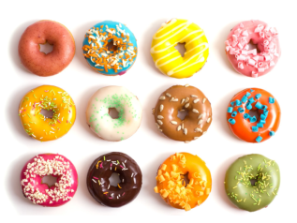

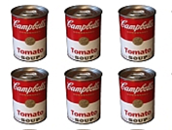
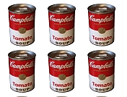
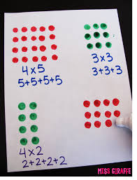

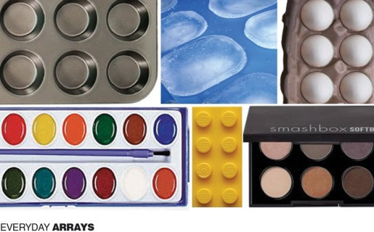
Monday Maths | Tuesday | Wednesday | Thursday | Friday
Arrays for counting An array is an arrangement of objects into rows. This array shows doughnuts in 3 rows with 4 doughnuts in each row. Which is written as a number sentence 4+4+4=12 or 4x3=12 Can you go on an array hunt around your house and see what you can find. Take pictures of the arrays and what it would look like when written as a number sentence. Talking about how many rows there are and how many in each row. Then think about how many altogether. Here are some ideas to help you; | Arrays Can you find tins in your cupboard in the kitchen or any objects that can stand up on their own would be fine. You will need 12. Can you think of all the different arrays you can make with these 12 objects. Take pictures or show your arrays written down as below. Repeat with a different start number: 16,20,25 | Arrays Today I would like to you to practice your 2,5 and 10 times tables by showing your understanding for each fact as an array. 1x2=2 ( 1, two times) 2x2=4 ( 2, two times) 3x2=6 (3, two times) All the way up to 12x2=? (12, two times) Then please repeat for the 5 and 10 times tables. Hint: you need to count carefully to make sure each row has equal numbers in. | Arrays For the last 3 days you have been creating arrays to show times table facts. Today you are still going to create arrays but this time instead of working on your times table facts you are going to show how dividing is the inverse (opposite) of multiplying (times tables). This time these doughnuts can be explained in a different way. In total there are 12 so the start number is 12. In one row there are 4 doughnuts and there are 3 rows. This information can be written as 12 4=3 12 into a row (group) of 4, three times. 6 in total, shared into groups of 3 two times. 3=2 Now try different arrays starting with the number 15, 24, 18, 12 | Arrays Today is the last day of arrays! I would like you to focus on your 3 times tables today. You are going to use an array to show the times table fact and the inverse division fact too. For example; 3x2=6 (3 in a group, 2 times) 3 2=6 (6 shared into groups of 3, two times) Start with 3x1=3 (a group of 3 one time, totals 3) So the division or inverse is 3 3=1 ( in total 3, a group of 3, one time) Now try all the way to 12x3= ? 3=12

Slide 3
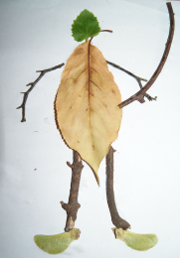


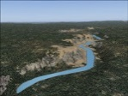

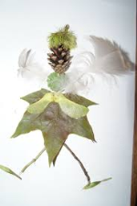
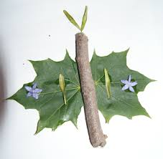
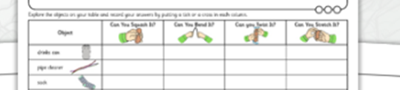

Monday | Tuesday | Wednesday | Thursday | Friday
Science Today in science you are going to find out how materials can change shape. It might be by an action you do to change the shape of the material, you could; Squash, squeeze, Push, pull, twist, cook or even melt Find any materials/objects in your house and see if they can change shape. Examples to try: Plastic bag, glass, pillow, chocolate, play dough, elastic band, paper. Record either by photos or create a table to show your results. | P.E/Art Go on a walk/bike/ scooter ride and collect anything you find. It may be a fallen leaf, a daisy, some rubbish, a twig, a stone, grass. I would then like you to create a picture with these items. You can stick the items on paper or take a photo of your creation. | RE During the month of May with think about our Mother Mary. The mother of Jesus and mother of us all. The prayer that we say to Mary is the Hail Mary Hail Mary full of Grace, the Lord is with thee. Blessed are thou amongst women and blessed is the fruit of thy womb Jesus. Holy Mary Mother of God, pray for us sinners now and at the hour of our death. Amen It would be lovely if this prayer is copied out in neat and decorated to show what a special prayer it is. This afternoon at school I am crowning the statue of Mary in the grotto at the church with a crown of flowers ,(hopefully for you to see on zoom, details to follow on parent pay or the website). You could even make your own crown for Mary. | Geography The continent of Africa is famous for many things. It has an enormous river called ‘The River Nile’ a desert called ‘The Sahara Desert’ and a mountain called ‘Mount Kilimanjaro’. Choose one of these famous geographical features and either: create a fact file display through pictures drawn or painted by you or printed from the internet 3d junk modelling Power point Poem I hope you have fun doing your research, I look forward to seeing what you come up with! | DT Why don’t you become a chef for the day! You could: bake a cake Make chocolate crispy cakes Help with dinner Make lunch for the family Bake bread Make pancakes Remember to tidy up afterwards. A simple recipe for 24 cupcakes: 250g butter 250g self raising flour 250g caster sugar Pinch of salt 4 medium eggs 4 tablespoons milk Oven cook for 25 minutes on 190 degrees or gas mark 5. All you have to do is mix all ingredients together and share into 24 cupcake cases! What could go wrong!!

