Slide 1
Year 2 Week beginning Monday 18th May 2020
Dear Parents,
Please find attached a timetable of activities that your child can complete this week. All activities are hopefully able to be completed without resources needed from school. Purple-mash and Ed-shed are still being updated regularly with activities that can also be completed. The hope is that everyone is able to access some form of activity whether computer based or by completing these activities. If you have any problems please contact the school and help will given.
A great way to start the day is with a prayer, quiet time asking God to keep them safe and help them with their learning. It could either be a chance for quiet, to say the Our Father, Hail Mary or the School Morning Prayer. This could then be followed by Joe Wicks, the Body Coach at 9:00am to get them active.
Our school email addresses ntew@stanthonys.slough.sch.uk KWoolley@StAnthonys.slough.sch.uk esoton@stanthonys.slough.sch.uk
This week you are going to write your own story book about Anansi. This time you will change some of the tricks in the story. You may use the guide on the next page to give you some ideas.
Monday | Tuesday | Wednesday | Thursday | Friday
Anansi Today you will plan to change the tricks for new ones. Look carefully at the grid on the next page to give you some ideas. Just make 1 bullet point for each change. This is an example: 1 Choose a new trick word. 2 What question will Anansi ask the animals? 3 What animals, will say what ? 4 How does your animal get tricked? | Using your new plan of Anansi, today you are going to write the beginning of your story. You can use the same beginning as Anansi. Remember to introduce Anansi and describe the idea he has to solve his problem. Use adjectives and similes Try using inverted commas – speech marks, in red. Anansi said, “ How many yams do you see? ” For each page of your story draw a picture just like a real book! | Today you are now going to write about how Anansi intends to trick the FIRST animal. Write about what happens when the first animal comes along. What does Anansi say? What does your chosen animal say? What happens? At the end of what happens, write an exclamation sentence for either Anansi or the animal. ‘How’ or ‘What’ How devious Anansi is! What a clever animal elephant is! Use adjectives and similes Try using inverted commas – speech marks, in red. | Repeat what you did yesterday with the second animal. Remember something different will happen. Remember to write your exclamation sentence for Anansi or the animal. ‘How’ or ‘What’ How ____ Anansi is! What a _____ ’animal elephant’ is! Use adjectives and similes Try using inverted commas – speech marks, in red. | Today you are going to write what happens when the last animal comes to see Anansi. What happens to Anansi? Use adjectives and similes Try using inverted commas – speech marks, in red.

Slide 2
Trick / word / number | Question they will ask. | Ellie the Elephant | Lenny Lion | Ziggy Zebra | Ending. What your character says
love | Do you like my yam hills? | I like them | I love them! POOF! | I don’t like them | What do you mean? I love them!
water | What do I need to make my Yams grow? | You need some beautiful sunshine. | I’ll get Ellie to use her trunk and put some water on it. POOF! | You need soil. | No, no, no! You forgot to say water. POOF!
River Nile | Which river do I need to go to, to get some water for my Yam Hills? | I can’t remember the name but it’s just over there. | From the River Nile. POOF! | I’m not telling you. You should have gone to school and learnt about rivers in Africa! | What a silly Zebra you are! It’s the River Nile. POOF!
Yes | Would you like to eat one of my Yams? | No, I prefer Mangoes. | Yes please! POOF! | Yeah! I would like one. | No, you need to say it in English, like this, “yes” POOF!
Monday for your plan;
1. Choose a new trick word. The same trick word will be used through the story.
2 What question will Anansi ask the animals?
3 What animals, will say what ?
4 How does your animal get tricked?

Slide 3



Monday Maths | Tuesday | Wednesday | Thursday | Friday
Create your own Anansi board game. You have already created a board game in school with your friend. Today you are going to create a board game based on Anansi. As the number 5 is so important in the story, on every 5th square something good or bad could happen that the player moves back, forward or misses a turn. You could make consequence cards to pick up if you land on a 5 number. (Go back to the start, count in 5’s to 100,etc) To make it more interesting you could draw and cut out pictures of the characters and place them carefully on your game or you could draw them straight on the paper. Look up board game templates to give you an idea of different layouts. | Play the game you created yesterday. As a warm-up count on and back in 5’s to 100. You will need your game, a dice and a counter/marker for each player. Have fun!! | Anansi Arrays challenge Today I have a challenge for you. How many legs does a spider have? 8 , 1 time = 8 x 1 = 8 8, 2 times = 8 x 2 = 8, 3 times = | Finding ¼ of shapes and numbers | Finding a fraction of a number Now draw one large square like the square above. Take a total from one of Wednesdays Anansi arrays and share it between the ¼ squares. If you choose for example; 16. Divide 16 between the 4 ¼ s How many in ¼ = How many in 2/4 or ½ = How many in ¾ = Repeat for a different total.
1/4
1/4
1/4
1/4
1/4
1/4
1/4
1/4
Draw 3 large squares like the one above and divide them into quarters. ¼
In the first large square shade ¼
Next large square shade 2/4 = ½
Then shade ¾ in the last square.
How far can you go?
80

Slide 4
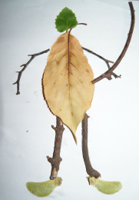
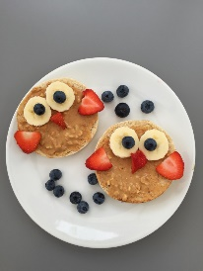
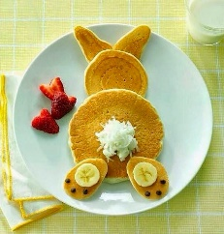


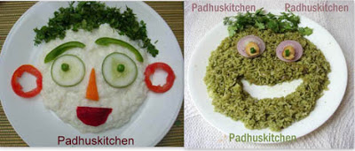

Monday DT | Tuesday Science |  |  |  | Wednesday RE | Thursday P.E | Friday ART
Design a front cover for your new story about Anansi. You will need a picture. A title Author and illustrators name. This is you by the way. | Changing materials YOU WILL NEED AN ADULT WITH YOU FOR THIS TEST! What happens to materials when they are heated? You will need: A slice of bread. Pieces of Chocolate. 1 Egg. Butter. Water. Make a grid. |  |  |  | Most Catholics use Rosary beads to pray with during the month of May. Do you have any Rosary Beads? Look at them carefully and place them somewhere safe, you may like to dedicate a small area in your home to Mary. Today you are going to write your own prayer to Mary. Think of all the things you know about Mary. Did you know that she appeared to three children in Fatima, in Portugal and to a girl called Bernadette in France. Find out about one of these events if you can. In your prayer ask for something special for the world. What could that be? When you have finished writing your prayer write Amen. Then decorate it nicely | Make an assault course in either living room of cushions and toys etc or garden. Can you walk the course …with a book or piece of fruit balanced on your head. How long can you do this for? Place another book on top if you are finding it easy. Choose an activity: https://home.jasmineactive.com/login The username is: parent@stanthonys-2.com The password is: stanthonys Every Thursday people have been clapping or banging saucepans for the NHS. Take a photo of you and your family clapping at 8:00pm (That’s if you are still up) | Food Art Can you create a fun looking sandwich or lunch with your favourite ingredients. Take a photograph and send it to your teacher. Surprise her! Don’t forget to eat it all up!
 | 1 | 2 | 3 | 4
 | Column 1 write the foods 2 describe what they look and feel like. 3. ADULT Heat the food, you describe what changed. 4. When it cooled did it return to its original state? What happened to the water? Look at a kettle when it boils water. What comes out of the spout?

