Slide 1
Year 2 Week beginning Monday 8th June 2020
Dear Parents,
Please find attached a timetable of activities that your child can complete this week. All activities are hopefully able to be completed without resources needed from school. Purple-mash and Ed-shed are still being updated regularly with activities that can also be completed. The hope is that everyone is able to access some form of activity whether computer based or by completing these activities. If you have any problems please contact the school and help will given.
A great way to start the day is with a prayer, quiet time asking God to keep them safe and help them with their learning. It could either be a chance for quiet, to say the Our Father, Hail Mary or the School Morning Prayer. See prayer sheet on the next page.
This could then be followed by Joe Wicks, the Body Coach at 9:00am to get them active.
Please read all the plans on Monday to prepare any resources you may need for the week. For example this week you will need seeds, soil and a pot. A piece of fruit. Look at the activities for Friday St Anthony’s feast day, Picnic food.
Our school email addresses ntew@stanthonys.slough.sch.uk KWoolley@StAnthonys.slough.sch.uk esoton@stanthonys.slough.sch.uk

Slide 2

Did you know, It is St Anthony’s Day this Saturday 13th June.

Slide 3
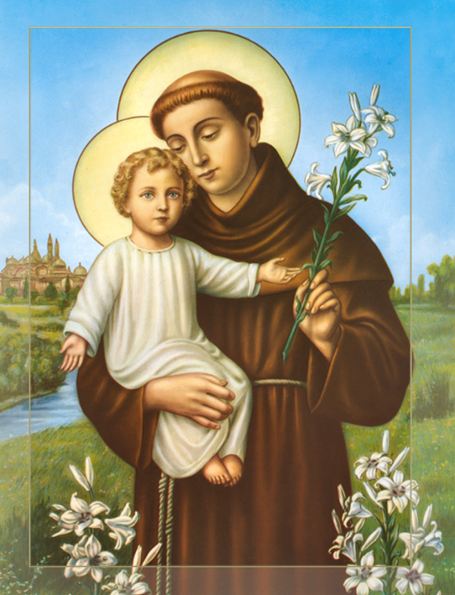
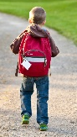
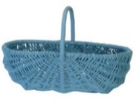
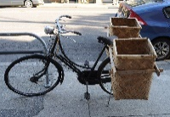
Literacy Monday | Tuesday | Wednesday | Thursday | Friday
Your surprise You are going to visit someone very special in your life, a best friend or favourite family member. Think about fruit and vegetables, and animals that are native to the UK and choose 7 of each then link each animal to a fruit or vegetable. Example: Fruit or Vegetables: blackberry, blueberry, grape, nut, redcurrant, strawberry, red pepper, radish, cucumber, tomato, lettuce, beetroot, runner bean, carrot. Animals: Fox, rabbit, deer, red kite, magpie, horse, cow, goat, badger, robin sheep, mouse, squirrel, dog, hedgehog, cat. Can you think of others? Towards the end of the journey an animal will knock into a tree, or be in a tree to drop fruit into your carrier. Some ideas: Knock into a tree: cow, horse, goat, sheep. In the tree; squirrels, starlings, woodpeckers. Fruit trees; cherry, apple, pear, plum. Can you think of others? Make your lists using adjectives. | Now you are going to plan your story. You will decide what carrier to put them in but make sure it is open. A back pack left open on your back. Box on a bicycle at the back. You’ve placed all 7 things into your carrier. Who are you taking them to? Where are you going to? Remember you’re walking through woodland. How are you travelling? walking- running-scootering- cycling? Then what happens towards the end of your journey? What animal knocks or drops what fruit from a tree as you pass? Your carrier is full of your favourite persons most favourite fruit? (Not originally placed in the basket.) When you meet your favourite person who will be surprised the most? | Today you are going to begin to write the introduction to your story adding extra detail. You should use adverbs, adjectives, conjunctions, and similes. Here is an example:. You decide on the setting of your journey. It could be trough Burnham Beeches, Black Park or Langley Park. Can you think of another? It was a wonderfully hot sunny day in the beautiful woods of Burnham Beeches in the United Kingdom. The sky was a beautiful blue and the bright white clouds were as fluffy as cotton wool balls. Beech trees were standing straight and tall making long dark shadows on the ground below like solders on guard at Windsor Castle. The leaves were rustling gently because of the soft summer breeze. Can you link sentences using some of these conjunctions: and, because, although, but, since, yet, until, when and while. REMEMBER: USE CAPITAL LETTERS and FULL STOPS! | Continue the story from when you place your fruits and vegetables into your basket and start the journey. Write about the first two animals and the fruits that they take, as you continue your journey. Draw a picture or cut out pictures to match each sentence. We will continue next week as tomorrow we will be celebrating St Anthony’s Day. | Tomorrow is St Anthony’s feast day. Today we would celebrate in school Say our school prayer to St Anthony. See the prayer sheet. Copy it or write your own prayer to St Anthony and decorate it.

Slide 4




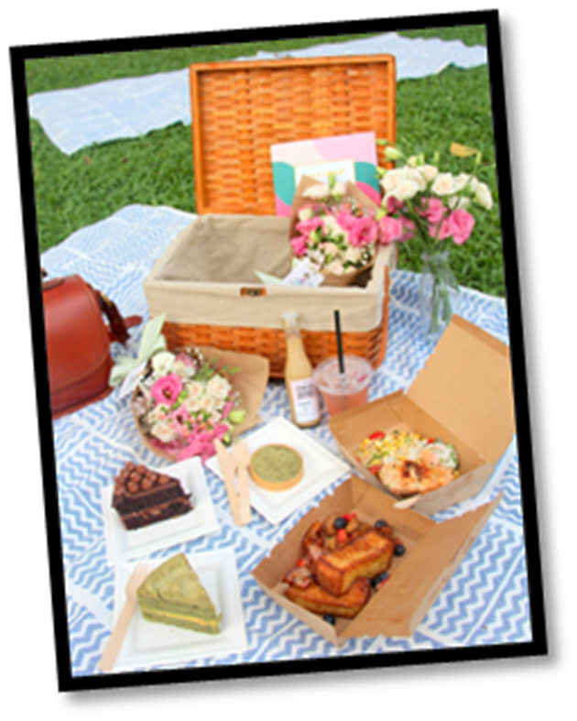
Monday Maths | Tuesday | Wednesday | Thursday | Friday
The number 7 is the focus number in Handa’s Surprise and your own story. List all the number facts of 7. 0 + 7 = 7 1 + 6 = 7 2 + 5 = 7 Continue Number facts of 70 using 10s 0 + 70 = 70 10 + 60 = 70 20 + 50 = 70 Can you see the pattern? Challenge: Write as many number sentences that equal 21 Start with repeated addition. 2+2 +2+2+2+5+5+1 = 21 28- 7 =21 Use: + - x ÷ | Today list all the number facts of 6 and 60 Challenge: using these symbols; + - x ÷ Write all the different number sentences that you can think of, that equal 12 and 24 20 +10 +6 =36 - = 36 _ X _ = 36 _ + _ - _ = 36 | List all the number facts of 8 and 80 Challenge: Look back at your Anansi counting in 8s work. It may help you. + - x ÷ Using the symbols write all the different number sentences that you can think of, that equal 16 and 48 | List all the number facts of 9 and 90 Challenge: using these symbols; + - x ÷ Write all the different number sentences that you can think of, that equal 27 and 54 | With your family, help to prepare delicious and special foods for your special picnic today. You have created some fun food art previously. Remember to take a photograph and send it to your teacher. Please state whether or not it can be used on the school website. Enjoy.

Slide 5
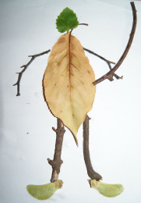


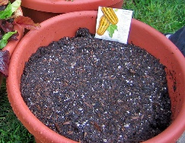
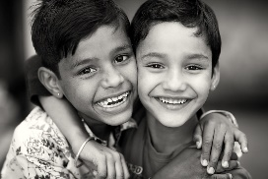
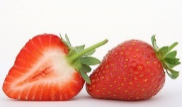
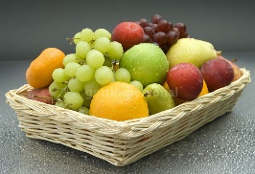


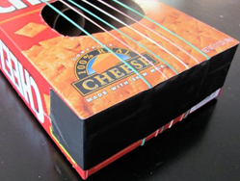
Monday P.E | Tuesday Art |  |  |  | Wednesday Science | Thursday DT
Choose an activity: https://home.jasmineactive.com/login The username is: parent@stanthonys-2.com The password is: stanthonys Watch and listen to Mrs Rudd as she reads, ‘We’re going on a bear hunt’. Click on the link below. https://www.youtube.com/watch?v=5T-VEZJhueU Go for a brisk walk with your family to a woodland area near you. | Today you will need a piece of fruit, blank paper, a drawing pencil, colouring pencils or paints. Take a good look at the fruit and place it on a plate in front of you. Think about the size of the fruit and look at the shape it makes on the outer edge. Draw it carefully so that it fills the page. |  |  |  | Plant a seed. You will need some seeds. Soil and Pot Radishes grow quickly, try growing a sunflower or tomato plant. What else will your seed need to help it grow? Take photos or draw pictures of how you planted your seed in sequence and label them. This will be the first page of your weekly diary. Each week you will record the length of the plant how many leaves etc. Draw each stage each week and record what is happening. Focus word: What does Germinate Mean? | Design and colour a front cover for your new story about taking fruit to your best friend. You will need a picture. A title Author and illustrators name. This is you by the way. | On St Anthony’s Day we usually have activities in school. Think about some of the activities we have in the playground. Create your own activity. Here are some ideas. It could be a gymnastics or sporting activity. Musical – sing a song – make a musical instrument using recycled materials -play an instrument. Create a dance! Make a picture.
 | Then look at the detail and colour it. Get an ADULT to cut the fruit in half and draw what you can see inside with detail and then colour Don’t forget to date and sign it like all great artists!

